Slide 1
Inventory Management System
for Business
Introduce the project and its key concepts

Slide 2
Our Team
Good team leads to success and the success reflicts the performance, efficiency and usability of any product and then these cards represent our impressive team.

Slide 3





Ahmed Ashour
Shimaa Essam
Nada Osama
Back-end Developer
Full Stack Developer
Back-End Developer
Ahmed Sherif
Fatma Emad
Digital Marketing Specialist
Front-End Developer

Slide 4

Problem Definition
Stock Mismanagement: Many inventory systems fail to handle real-time stock tracking, leading to over-ordering or under-stocking.
Inflexibility in Orders: Systems may not manage dynamic updates, such as product shortages or customer-specific order processing.

Slide 5

Problem Solution
Real-Time Stock Management: Your system disables order creation when product quantities exceed available stock, ensuring accurate stock levels.
Enhanced Order Management: Detailed order tracking and customer-specific functionalities ensure better handling of orders and stock validation using shopping Cart Package that ensure that.

Slide 6
What We did?
We are going to discuss the main concepts like features , phases and time that we covered in this project to achieve the optimal solution for the Inventory System.
In next slide, we will show the sprints of project

Slide 7
Sprint Planning
Sprint 1
Sprint 2
Sprint 3
Sprint 4
Sprint 5
Authentication and User Management.
Product, Category, Supplier Management.
Orders, Customers, and Units
Purchases, Stock Management, Quotations.
Testing, Debugging, and Final Refinements.

Slide 8
Authentication and User Management.
Product, Category, Supplier Management.
Orders, Customers, and Units
“Here, we create user validations that he can modify or remove data depend on his authorization permissions”
“Make the products and their categories which have relations with each other and suppliers who make purchases for these products”
“Make the orders operations with the customer who has the permission to create them”

Slide 9
Purchases, Stock Management, Quotations
Testing, Debugging, and Final Refinements.
“Handle all purchases operations and ensure that required quantity is exist in the stock and quotations that breakdown order details ”
“Ensure the reliability and scalability of the system and the flow works smoothly ”

Slide 10
What next?
Here we ‘ve just discussed the sprints and the lock of the system and now it’s time for representing the analytical description of the flow.

Slide 11
Functional Requirements
Authentication, Inventory Management, Orders and Customers, Purchases and Stock, Quotations.
Non-Functional Requirements
Performance, Security, Usability, Scalability, Reliability.
Analysis
Data Requirements
Entities, Data Integrity.
Technical Feasibility
Tools and Frameworks, Dependencies.
Potential Issues, Mitigations.
Risk Analysis

Slide 12
How to design it?
In previous section, we analyzed the system and extracted the key analytical concepts that we are going to design them in upcoming slides.

Slide 13
Design System
Architectural Design
Using MVC Framework that integrate the logic behind entities and the view of the system.
Database Design:
Visualize the tables and their relationships and considering the 3rd normalization for avoiding redundancy

Slide 14
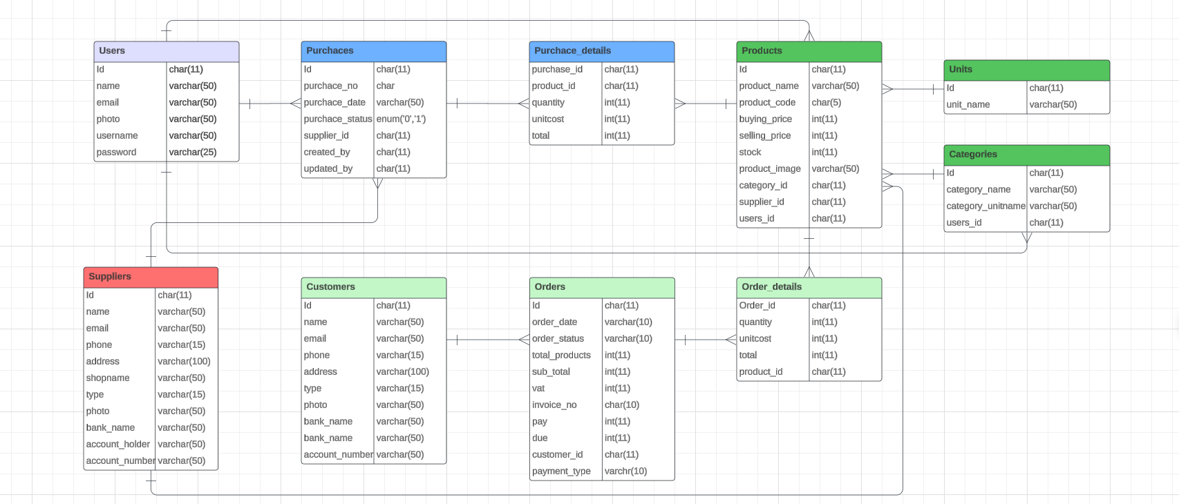
Database Design

Slide 15
How to implement?
Finally, we ‘ve just completed the basic requirements for establishing a real system and then it’s time to go through the development.

Slide 16
Implementation steps
01
02
03
Step
Step
Step
04
05
06
Step
Step
Step
Code Development
Database Configuration
User Interface Implementation
Authentication Implementation
Testing
Version Control and Deployment:

Slide 17
Implementation steps
Code Development
Database Configuration
User Interface
Handle Controllers and logic behind the system.
Handle Migrations , seeders and other concerns
Optimize blade templets for all in entities.
Authentication
Testing
Deployment
Implement user validations and his permissions
Manage Scalability & Reliability for the system
Use local hosting or domains for production

Slide 18

Conclusion
We hope that the requirements satisfy customer’s needs and well feedback on our services.

Slide 19
Thanks!
Does anyone have any questions?
I hope you enjoyed
the presentation🥰✨
Please keep this slide for attribution

